Slide 1
MICROSOFT EXCEL
Name:Praveenkumar. P
Register No: 312203173, asunm161312203173
Department :B. ComA&F
College : Prince shri venkateshwara
art &science college

Slide 2
INTRODUCTION:
Microsoft Excel is a spreadsheet editor developed by Microsoft for Windows, macOS, Android, iOS and iPad OS. It features calculation or computation capabilities, graphing tools, pivot tables, and a macro programming language called Visual Basic for Applications. Excel forms part of the Microsoft 365 suite of software.
Excel has the following formatting options:
Text orientation:
Chooses the angle for the text either diagonal or vertical orientation.
Wrap text:
Makes all the text visible within a cell without displaying on other cells.
Merge & centre:
It applies common title foe a data. Joins the selected cells into one large cell & centers the contents. Often used to create lable that span multiple columns.

Slide 3
Conditional formatting:
This helps to look up higher/lower values, and also helpful in finding duplicate vales in a data.
Pivot table:
Summarize data using pivot table. Pivot table makes it easy to arrange and summarizes complicated data and drill down details.
Advanced filter:
Advance filter is used to filter down data with complex criteria.
Example: employee salary, GST calculations etc.,
Macros:
Macros is a set of tasks or actions that we perform regularly and that can be recorded, saves and executed at any time. It is a VBA driven programming language.

Slide 4
Usage of excel:
Excel is most commonly used in business settings. For example, it is used in business analysis, human resource management, operations management and performance reporting. Excel uses a large collection of cells formatted to organize and manipulate data and solve mathematical functions. Users can arrange data in the spreadsheet using graphing tools, pivot tables and formulas. The spreadsheet application also has a macro programming language called Visual Basic for Applications.
An XLS file is a spreadsheet file that can be created by Excel or other spreadsheet programs. The file type represents an Excel Binary File format. An XLS file stores data as binary streams -- a compound file. Streams and sub streams in the file contain information about the content and structure of an Excel workbook.
Versions of Excel after Excel 2007 use XLSX files by default, since it is a more open and structured format. Later versions of Excel still support the creation and reading of XLS files, however. Workbook data can also be exported in formats including PDF, TXT, Hypertext markup language, XPS and XLSX.
Macro-enabled Excel files use the XLSM file extension. In this case, macros are sets of instructions that automate Excel processes. XLSM files are similar to XLM files but are based on the Open XML format found in later Microsoft Office software.

Slide 5
Functions:
Excel 2016 has 484 functions. Of these, 360 existed prior to Excel 2010. Microsoft classifies these functions into 14 categories. Of the 484 current functions, 386 may be called from VBA as methods of the object Worksheet Function and 44 have the same names as VBA functions. With the introduction of LAMBDA, Excel became Turing complete.
History:
From its first version Excel supported end-user programming of macros (automation of repetitive tasks) and user-defined functions (extension of Excel's built-in function library). In early versions of Excel, these programs were written in a macro language whose statements had formula syntax and resided in the cells of special-purpose macro sheets (stored with file extension .XLM in Windows.) XLM was the default macro language for Excel through Excel 4.0.
Beginning with version 5.0 Excel recorded macros in VBA by default but with version 5.0 XLM recording was still allowed as an option. After version 5.0 that option was discontinued. All versions of Excel, including Excel 2021, are capable of running an XLM macro, though Microsoft discourages their use.

Slide 6
Formulas:
Sum
Maximum
Minimum
Average
Year fraction
Result
Roman letters
Weekend
Dated if
Sum if
Count if
Nested If
Profit & loss
V-lookup
D-max
Average if
H-lookup
D-sum and even more.

Slide 7
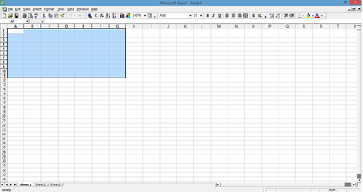
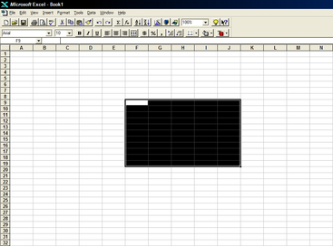
Different versions of excel:
Microsoft excel ‘95 version and 2000 version

Slide 8
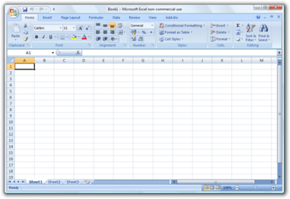
Microsoft excel 2007 version:

Slide 9
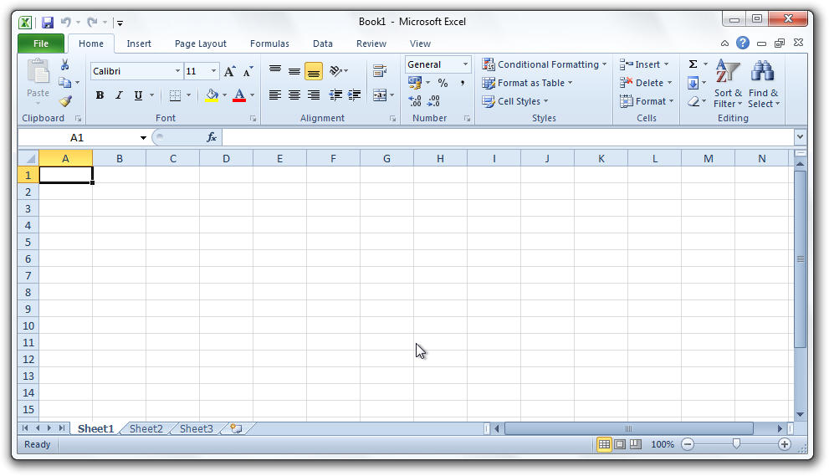
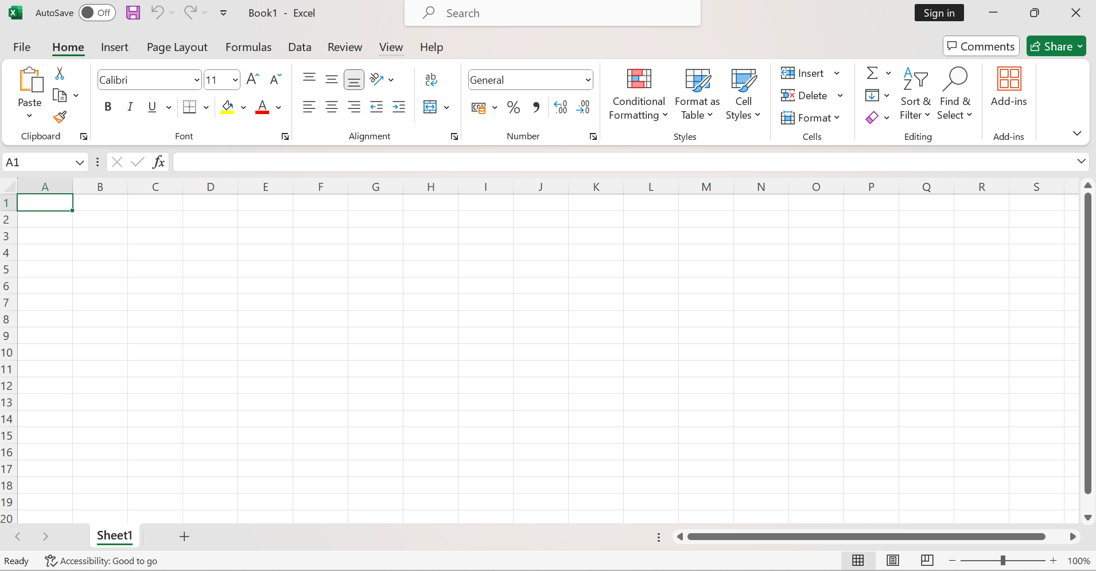
Microsoft 2010 and latest version:

Slide 10
Advantages:
Disadvantages:
Limited Data Handling: Excel has limitations in handling large datasets efficiently, leading to performance issues and potential data loss or corruption.
Prone to Errors: Human errors, like incorrect formulas or data input, can occur, leading to inaccurate results, especially in complex spreadsheets.
Version Control and Collaboration: Managing versions and collaborating on a single Excel file can be challenging, leading to confusion and potential data conflicts.
Lack of Security: Excel files may lack robust security features, making them vulnerable to unauthorized access, data breaches, or accidental alterations.
Complexity in Complex Tasks: While it's user-friendly for basic tasks, performing complex operations might require advanced knowledge of formulas, functions, and VBA programming.
Limited Automation: While Excel supports automation through macros, it might not be as efficient as dedicated programming languages or software for extensive automation and complex tasks.
Versatility: Excel allows users to perform various tasks like calculations, data analysis, charting, and more within a single platform.
Ease of Use: Its user-friendly interface makes it accessible to users with varying levels of expertise. Basic functions can be quickly learned and applied.
Data Analysis Tools: Excel provides powerful tools for data analysis, including formulas, functions, pivot tables, and charts, aiding in insightful data interpretation.
Customization: Users can customize Excel through macros, add-ins, and personalized functions to suit specific requirements, enhancing its functionality.
Compatibility: Excel files (.xlsx) are widely supported across different platforms, ensuring easy sharing and collaboration.
Graphical Representation: It offers a range of charting options, enabling users to represent data for better understanding and visual presentation.

Slide 11
Competitors of excel:
Even though Excel might be one of the most recognizable spreadsheet programs, other vendors offer competing products. Examples include the following:
Google Sheets. Google Sheets is a free competitor to Excel, with similar layouts and features. Users with a Gmail account can access Google Sheets. Google Sheets are saved in the cloud, meaning users can access their spreadsheets from anywhere and on numerous devices. Multiple users can also collaborate on the same spreadsheet.
Numbers. Apple's spreadsheet program comes free with every Mac and provides prebuilt templates, charts and graphs. Numbers excels at graphics and charts, but it does not handle large data sets as well as Microsoft Excel. Numbers is also exclusive for Apple's devices. But it does enable users to save spreadsheets as Excel files, so a Windows user can still open a Numbers spreadsheet in Excel.
Apache OpenOffice Calc. This free open source spreadsheet software features multiple user collaboration; natural language formulas that enable users to create formulas using words; Data Pilot, which pulls data from corporate databases; and style and formatting features that enable different cell formatting options. The software uses a different macro programming language than Excel and has fewer chart options. OpenOffice Calc works on Windows and macOS platforms. OpenOffice Calc also uses the Open Document Format as its default, with only limited support for Microsoft's XLSX format.

Slide 12
Conclusion:
In conclusion, Microsoft Excel is a fundamental tool for data management and analysis, offering many features that cater to diverse user needs. Its versatility, ease of use, and robust data analysis capabilities make it an indispensable asset in various fields. However, while Excel excels in many areas, it's essential to acknowledge its limitations, especially when handling extensive datasets and complex tasks. For individuals pursuing a Master’s in Computer Science, understanding Excel's strengths and weaknesses can complement their skill set, particularly in data analysis and management, which are integral aspects of the field.

